Slide 1
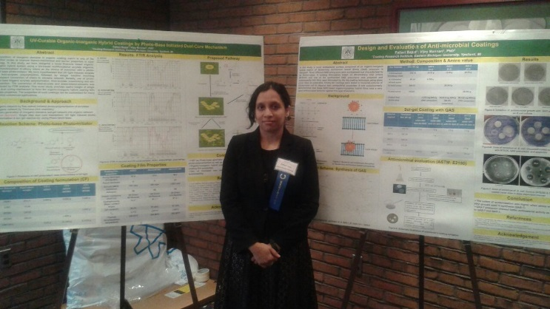
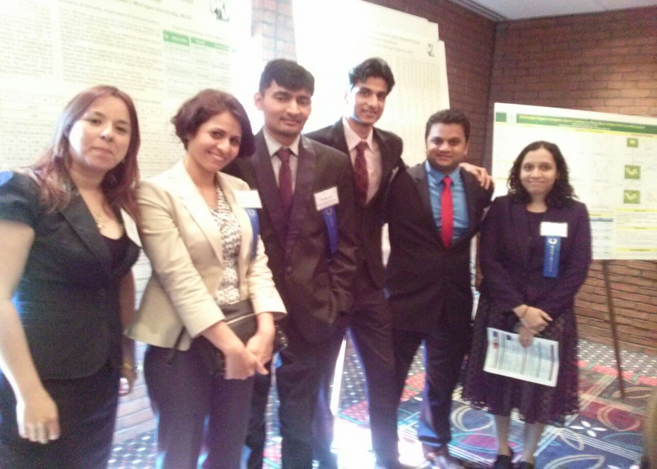
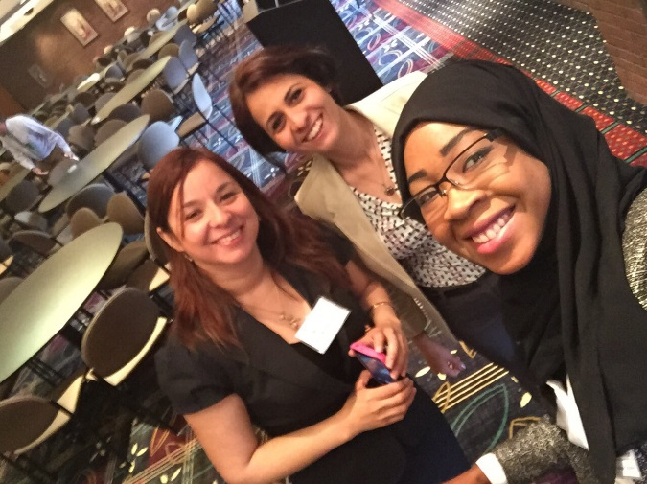
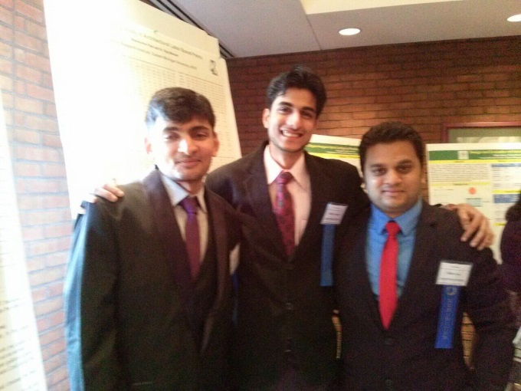
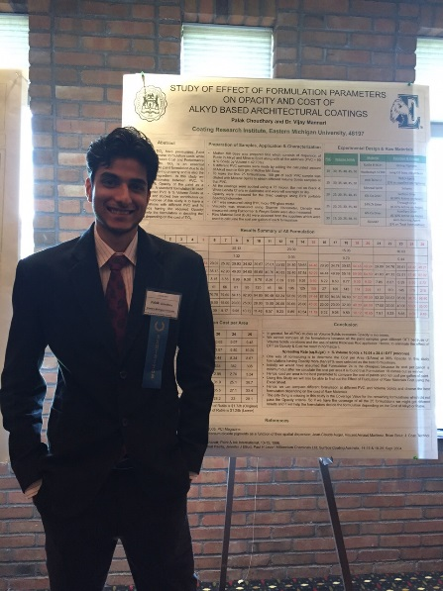
EMU COT Students Take - 1st, 2nd, 3rd Place Awards
I realized that Focus is a great place to know people in this field who constantly inspire us to learn and grow. Pallavi Bapat
FOCUS
May 7, 2015
The Detroit Society for Coatings Technology
The conference is a very good platform for the students to Network and make connections with people involved in the field of Coating.
Palak Choudhary
This conference which is organized by the Detroit Society for coatings technology provides me an environment to know about the successes and innovations in coating industry that will give me better ideas about my research. Mahshid Niknahad

