Slide 1

Administrative
Leadership
Meeting
Tuesday, April 19, 2016

Slide 2
Today’s Agenda:
Welcome
Don Loppnow, Interim President
*Great Colleges To Work For Survey Results & Action Plan
David Turner, Vice President for University Human Resources
*Capital Plan
John Donegan, Vice President for Facilities & Operations
*The Honors College
Rebecca Sipe, Assistant Vice President for The Honors College
Closing Remarks & Open Q&A
Notes:
DON’S INTRODUCTORY COMMENTS:
Received outstanding feedback from employees on the surveys we distributed at the last meeting
A list of every response to the questions from the February meeting will be posted online after this meeting.
A copy of those responses is at each table – only one copy to save paper because it’s more than 40 pages in length!
Today, we will begin with a brief overview of your responses
After that, Kevin Kucera will provide a brief overview of enrollment trends and plans – this was a popular request in the survey responses
After that, Mike Valdes will provide an update about the current year’s budget
Q&A available after each presentation
A few copies of today’s presentations are available at your table in case you can’t see the screens, and today’s presentation will be posted online later today.
We also posted February’s presentation online.
We’ll close with table discussion, another (much shorter) survey, and final Q&A

Slide 3
The Chronicle of Higher Education: Great Colleges To Work For 2015
All Administrative Professional Meeting
Eastern Michigan University

Slide 4
Agenda
Survey Review
Action Plan Review
Proposed Next Steps

Slide 5
Survey Overview
Conducted Winter/Spring 2015
Measured the extent to which employees are involved and engaged in the organization and the quality of the workplace experience
The survey contained:
  Sixty engagement statements utilizing a five-point agreement scale
  Eighteen benefits satisfaction items
  Fifteen demographic questions
  Two open-ended questions

Slide 6
Survey Dimensions
Job Satisfaction
Teaching Environment
Professional Development
Compensation, Benefits & Work/Life Balance
Facilities, Workspace & Security
Policies, Resources & Efficiency
Shared Governance
Pride
Supervisor/Department Chairs
Senior Leadership
Faculty, Administration & Staff Relations
Communication
Collaboration
Fairness
Respect & Appreciation

Slide 7
From 2013 to 2015: Dimensions Overview
  Job Satisfaction—from Fair/Moderate (62%) to Good (68%)
  Teaching Environment—unchanged
  Professional Development—from Fair/Moderate (64%) to Good (66%)
  Compensation, Benefits & Work/Life Balance—unchanged
  Facilities, Workspace & Security—from Fair/Moderate (62%) to Good (65%)
  Policies, Resources & Efficiency—unchanged
  Shared Governance—unchanged
  Pride—from Fair/moderate (64%) to Good (65%)
  Supervisor/Dept Chairs—from Fair/Moderate (62%) to Good (69%)
  Senior Leadership—unchanged
  Faculty, Administration & Staff Relations—unchanged
  Communication—unchanged
  Collaboration—unchanged
  Fairness—unchanged
  Respect & Appreciation—from Warrants Attention (54%) to Fair to Moderate (57%)

Slide 8
Random Sample Size & Response Rate
 | Total Population (IPEDS) | Survey Sample Size | Respondents | Response Rate
Administration* (AP) | 180 | 57 | 32 | 56%
Full-time Instructor (FA & LE) | 775 | 285 | 82 | 29%
Exempt Professional (AC, VF, AP & PE) | 364 | 191 | 55 | 29%
Non-exempt Staff (AH, PT, CS, CA, FM, CP, & PS) | 625 | 67 | 12 | 18%
Total | 1944 | 600 | 171 | 33%
* Represents Supervisory Through Upper Management Staff
CP = Campus Police
CS = Clerical/Secretarial
FA = Faculty
FM = Food Services Maintenance
LE = Full-time Lecturer
PS = Police Sergeant
PT = Professional Technical
PE = Professional Exempt
VF = Visiting Faculty

Slide 9
Highest Performing Dimensions
Compensation, Benefits & Work/Life Balance (74%)
  I am paid fairly for my work.
  This institution’s benefits meet my needs.
  My supervisor/department chair supports my efforts to balance my work and personal life.
  This institution’s policies and practices give me the flexibility to manage my work and personal life.
Supervisor/Department Chairs (69%)
  My supervisor/department chair makes his/her expectations clear.
  I receive feedback from my supervisor/department chair that helps me.
  I believe what I am told by my supervisor/department chair.
  My supervisor/department chair regularly models this institution’s values.
  My supervisor/department chair is consistent and fair.
  My supervisor/department chair actively solicits my suggestions and ideas.
  I have a good relationship with my supervisor/department chair.
Job Satisfaction & Support (68%)
  My job makes good use of my skills and abilities.
  I am given the responsibility and freedom to do my job.
  I am provided the resources I need to be effective in my job.

Slide 10
Five Highest Rated Statements
My supervisor/department chair supports my efforts to balance my work and personal life (Compensation, Benefits, Work Life Balance).
I understand how my job contributes to this institution's mission (Pride).
I am given the responsibility and freedom to do my job (Job Satisfaction & Support).
I have a good relationship with my supervisor/department chair (Supervisor & Dept. Chair).
At this institution, people are supportive of their colleagues regardless of their heritage or background (Respect & Appreciation).
Note: The numbers represent the percentage of positive responses.

Slide 11
Lowest Performing Dimensions
Senior Leadership (38%)
  Senior leadership provides a clear direction for this institution’s future.
  Our senior leadership has the knowledge, skills and experience necessary for institutional success.
  Senior leadership shows a genuine interest in the well-being of faculty, administration and staff.
  Senior leadership communicates openly about important matters.
  Senior leadership regularly models this institution's values.
  I believe what I am told by senior leadership.
Faculty, Administration & Staff Relations (43%)
  Faculty, administration and staff work together to ensure the success of institution programs and initiatives.
  There is regular and open communication among faculty, administration and staff.
Communication (46%)
  When I offer a new idea, I believe it will be fully considered.
  In my department, we communicate openly about issues that impact each other's work.
  Changes that affect me are discussed prior to being implemented.
  At this institution, we discuss and debate issues respectfully to get better results.

Slide 12
Five Lowest Rated Statements
Note: The numbers represent the percentage of positive responses.

Slide 13
Summary & Actionable Steps
Lowest Performing Dimensions:
  Senior Leadership
    Unclear directions for the institution’s future
    Being open about important issues
  Faculty, Administration & Staff Relations
    Faculty, administration and staff work together to ensure the success of institution programs and initiatives.
    There is regular and open communication among faculty, administration and staff.

Slide 14
About the Employee Comments
Two open-ended questions were asked:
  What do you appreciate most about working at this institution?
  What would make this institution a better place to work?

Slide 15
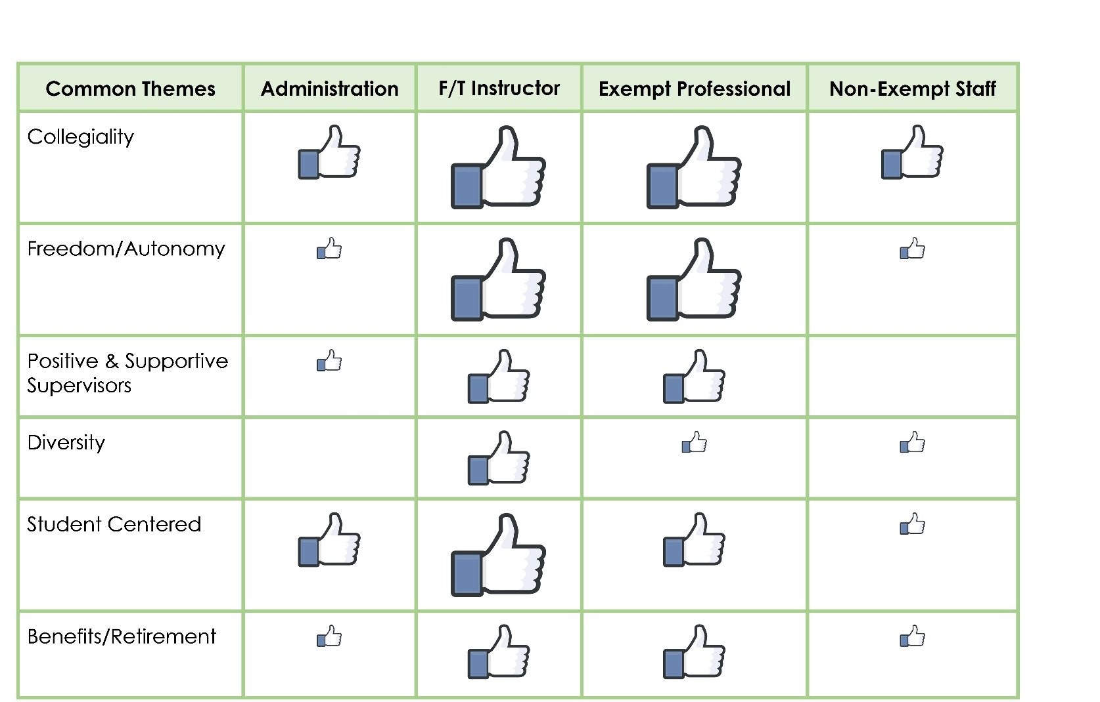
What do you appreciate most about working in this institution?
Size of the icon represents the magnitude of counts of responses

Slide 16
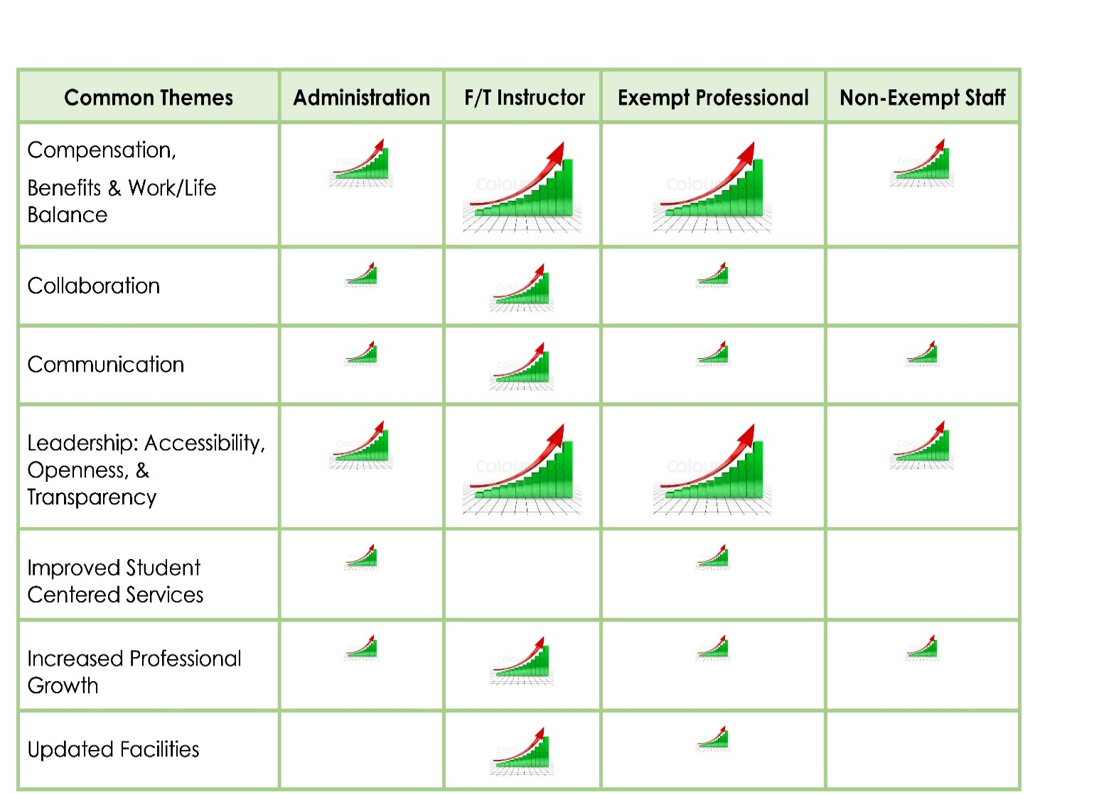
What would make this institution a better place to work?
Size of the icon represents the magnitude of counts of responses

Slide 17
Leadership Priorities:
What are we going to do?
Increase the Communication Flow and Opportunities to Engage
Increase Transparency
Demonstrate our strategic themes, goals & objectives in our leadership actions
Do what we say we are going to do

Slide 18
To do list:
  Share results with campus
    Post detailed presentation on University websites (HR, strategic planning, communications, president, All AP Meeting, etc.)
    Executive Council leaders (EC) share results and leadership priorities with respective leadership teams and staff
    EC and staff to develop division priorities (action plans)
    Concurrently share results with Union leadership (All Union Council)
  Integrate results with future communications regarding strategic plan
  Track and share division action plans & results at future EC meetings
  Participate in GCTWF survey in 2017 to track changes and trends (Winter/Spring 2017)

Slide 19

Question and Answers

Slide 20
Table Exercise
What type of information would be helpful to you in order to help improve transparency within the University?

Slide 21

UNIVERSITY FUN FACTS:
Total Building Area: 3,109,070 s.f.
Cost of Operation: $53,583/Day - $6.29/sf
Utility Costs: $20,500/Day
Campus Area: 600 Acres +
Roadways: 5.2 miles
Sidewalks: 22.9 miles
Parking Lots: 28 lots with 10,284 spaces

Slide 22
Physical Plant Administration
  Departments include:
      Facilities Planning & Construction
        Scott Storrar – Director
        Bob Densic, R.A. – University Architect
      Facilities Maintenance
        Bilal Sarsour – Director
      Custodial, Grounds, & Parking
        Dieter Otto – Director

Slide 23
Facilities Planning & Construction responsibilities include:
  Capital planning
  Programming
  Space Utilization
  Design
  Construction
    New Construction
    Renovations (major & minor)
    Asset Preservation
    Campus site & utility projects

Slide 24
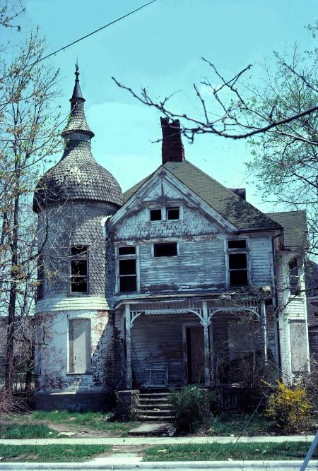
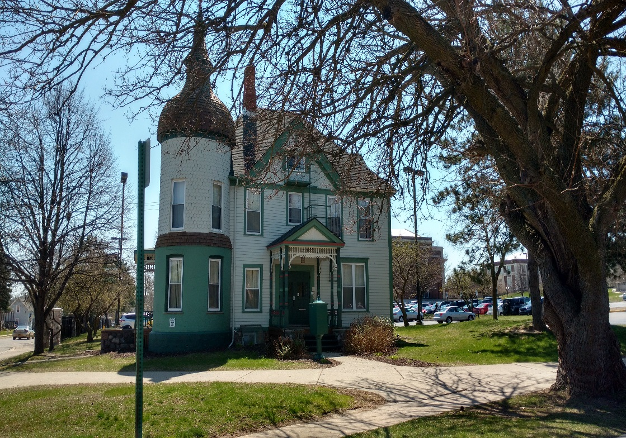
Physical Plant… getting things DONE!
Before
After

Slide 25
Funding Sources
State Capital Appropriations
Michigan’s Capital Outlay Process
  Submit project requests to the State annually
Previous State Capital Appropriation Projects include:
  Porter Renovation, 1993, $57.6M
  Health & Human Services Bldg., 1996, $20.4M
  Pray Harrold Renovation, 2009, $42M
Self Funded
Local Capital Projects (major/minor)
  General
  Auxiliary
Asset Preservation
  General
  Auxiliary
Energy
Safety
IT
Parking
Athletics

Slide 26
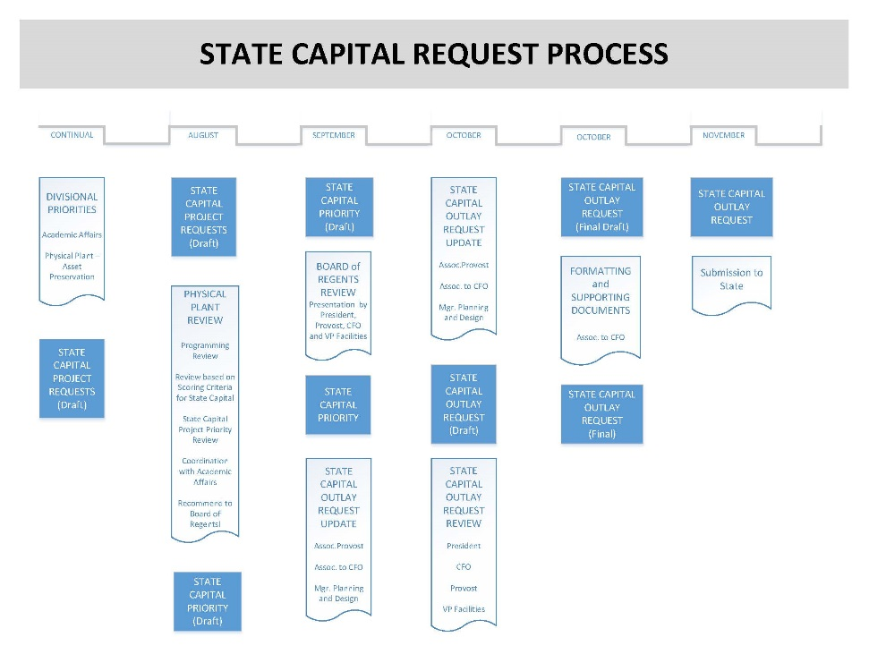

Slide 27
State Capital Outlay FY 2017
Strong Hall
      Top priority since 2009
      Recommended in the Governor’s FY17/18 Budget
      Complete Building Renovation
      Project Budget: $39.5m
      Existing Building Size: 87,500 s.f.
      Built: 1957
      Physics, Astronomy, Geology, Geography, Historic Pres.

Slide 28
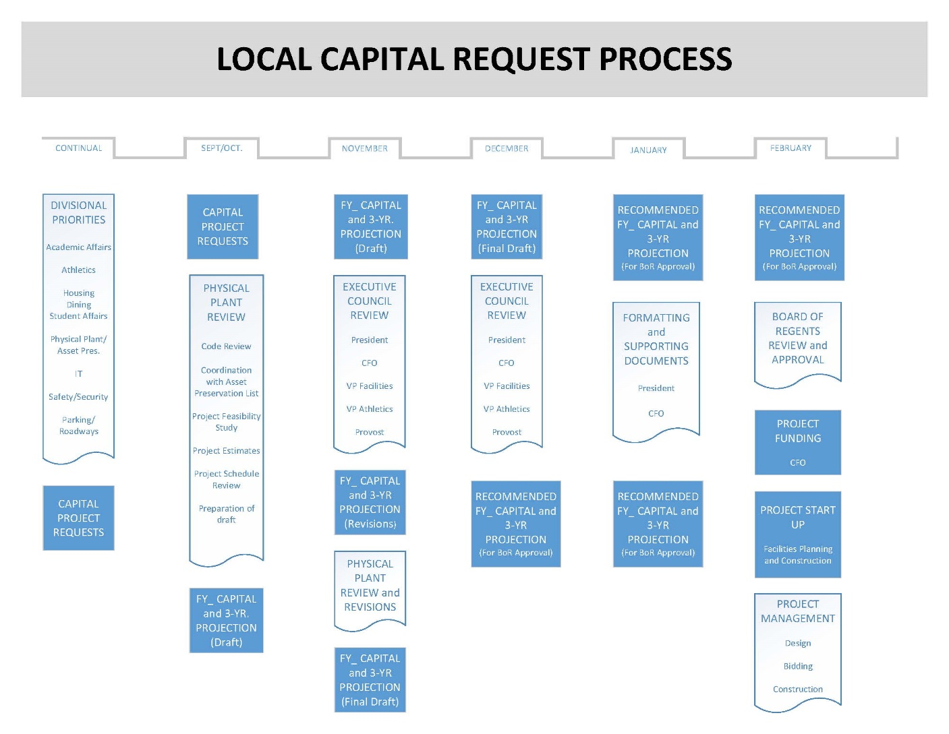

Slide 29
  Local Funded Capital Projects:
  Recently Completed / In progress: ($27M)
    Rackham Hall renovation, final phase ($6.3 M)
    Sculpture Studio addition/renovation ($1.3 M)
    Campus Safety Measures ($765,000)
    Classroom Technology ($875,000)
    Campus Parking/Flatwork ($1.0 M)
    Misc. Housing minor renovations ($550,000)
    Honors College Purchase & Repairs ($1.05 M)
    Relocation of Univ. Foundation to McKenny ($400,000)
    Wise Hall Renovation Phase I & II ($5.6 M)
    Campus Energy Savings Phase I & II ($7.05 M)
      Lighting, controls, replacing mechanical equipment & fixtures

Slide 30
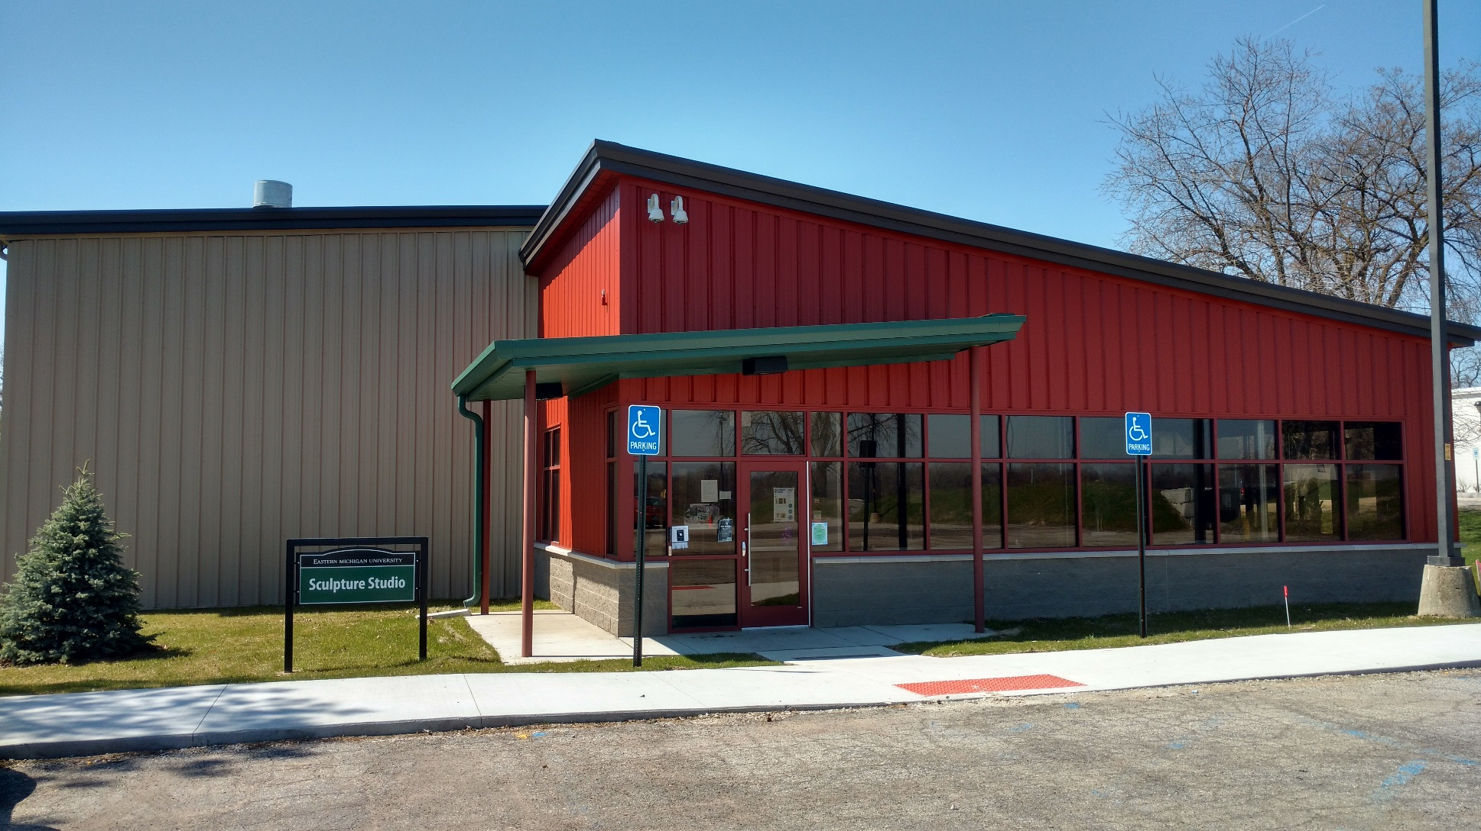
Sculpture Studio

Slide 31
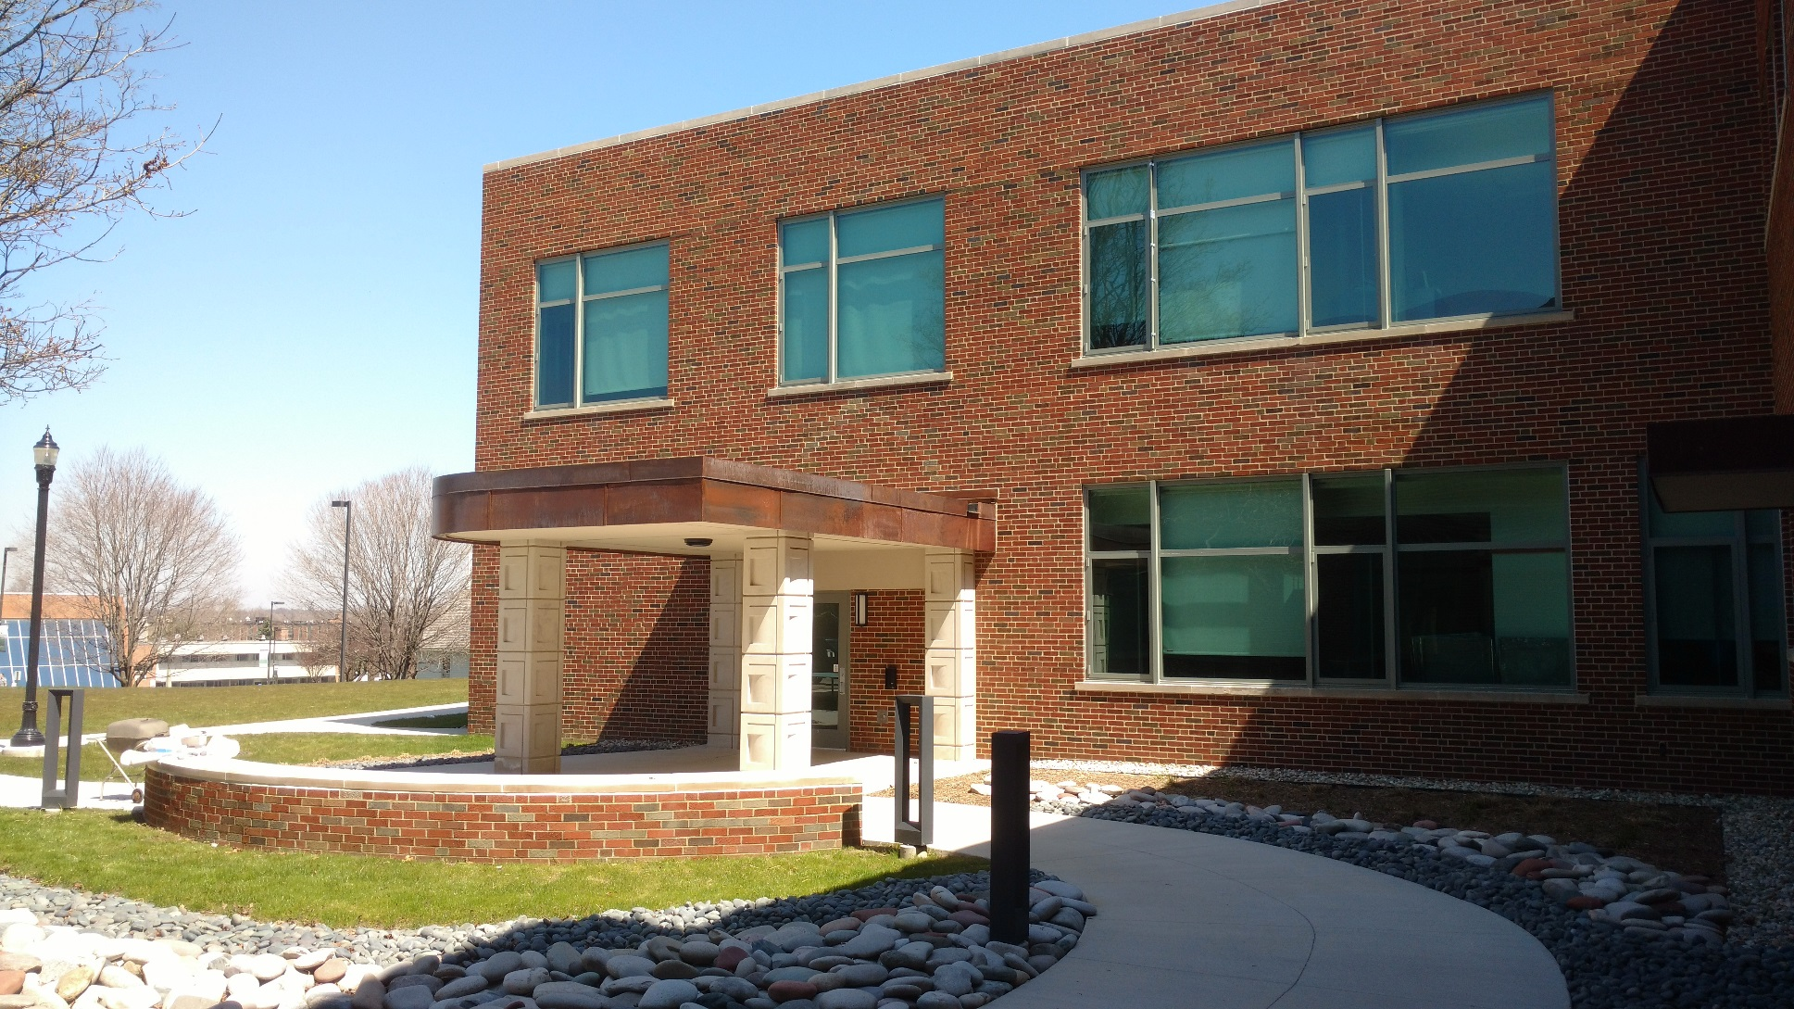
Rackham

Slide 32
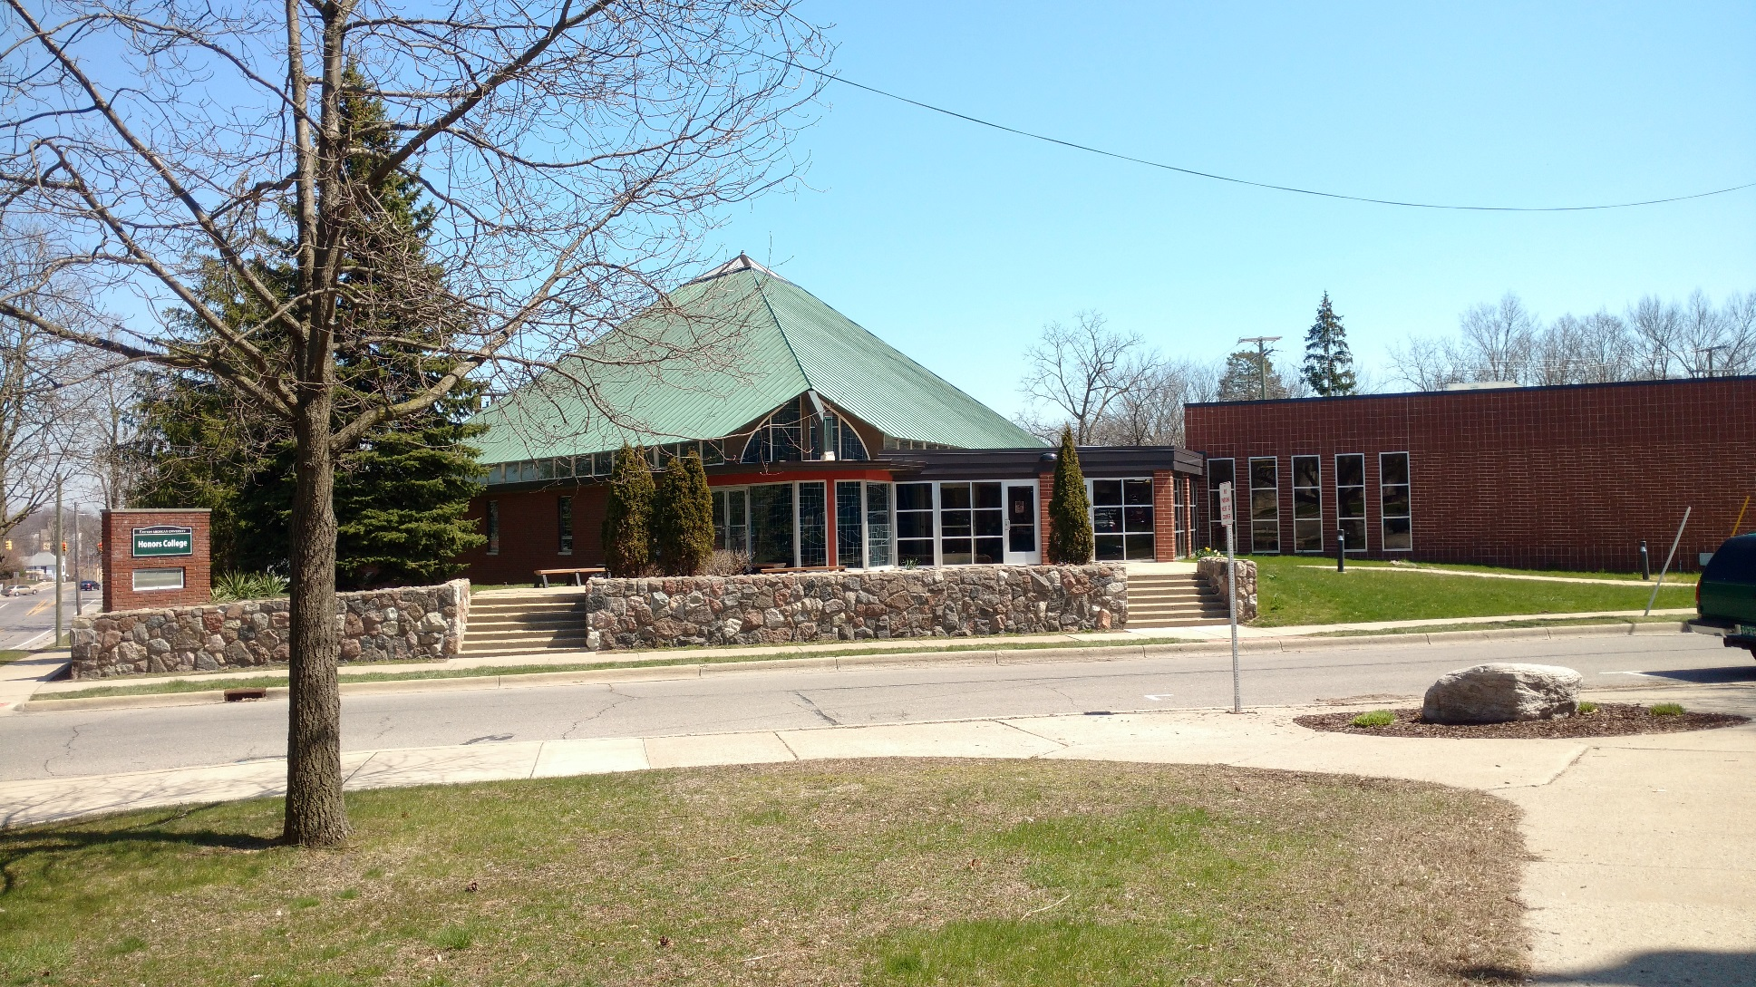
Honors College

Slide 33
Upcoming Projects (17.4M)
(Board Approved FY 17)
    College of Technology – Programming ($250,000)
    Warner Building Program – Backfill from Rackham project ($250,000)
    Strong Hall – Capital Outlay EMU share ($9.9M)
    Wise Hall – (Phase III) continuation of current project ($2.8M)
    Green Lot II – Replacement ($1.2M)
    Ford Lot – Replacement ($400,000)
    Ford Lot – Decorative fencing and columns ($150,000)
    Miscellaneous Campus Flatwork ($450,000)
    Putnam Hall – Update finishes ($150,000)
    Campus Security Measures – cameras & infrastructure ($250,000)
    Public Safety Building – Site work, final phase ($250,000)
    East Campus Lighting – Installation new LED fixtures ($150,000)
    Classroom Technology ($870,000)
    Rynearson Stadium – Misc. repairs ($350,000)

Slide 34
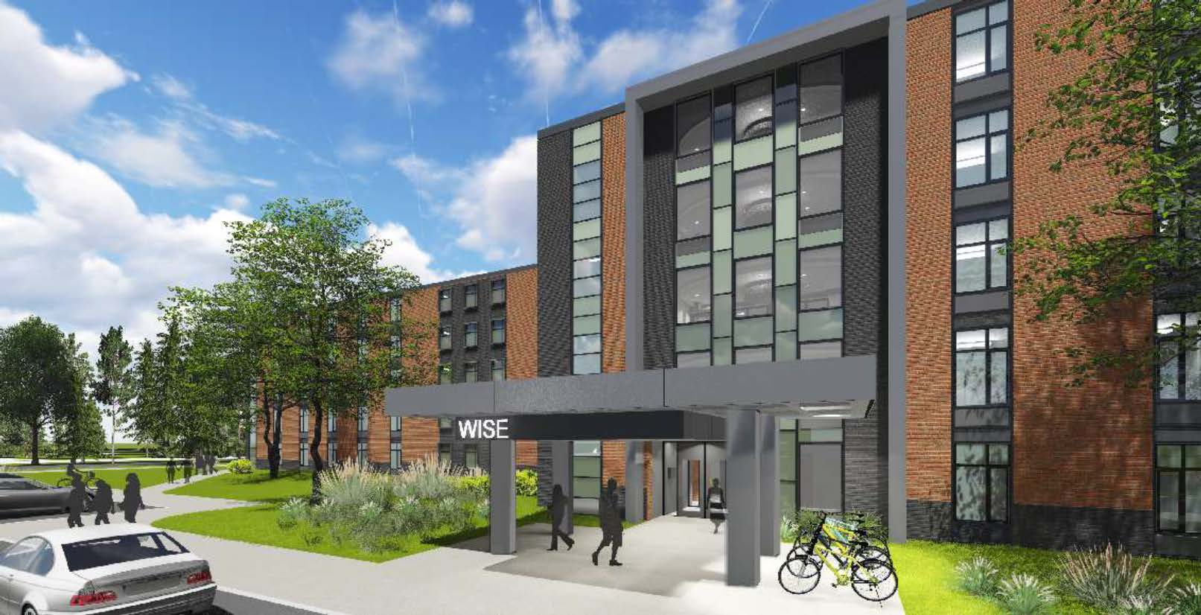
Wise Hall

Slide 35
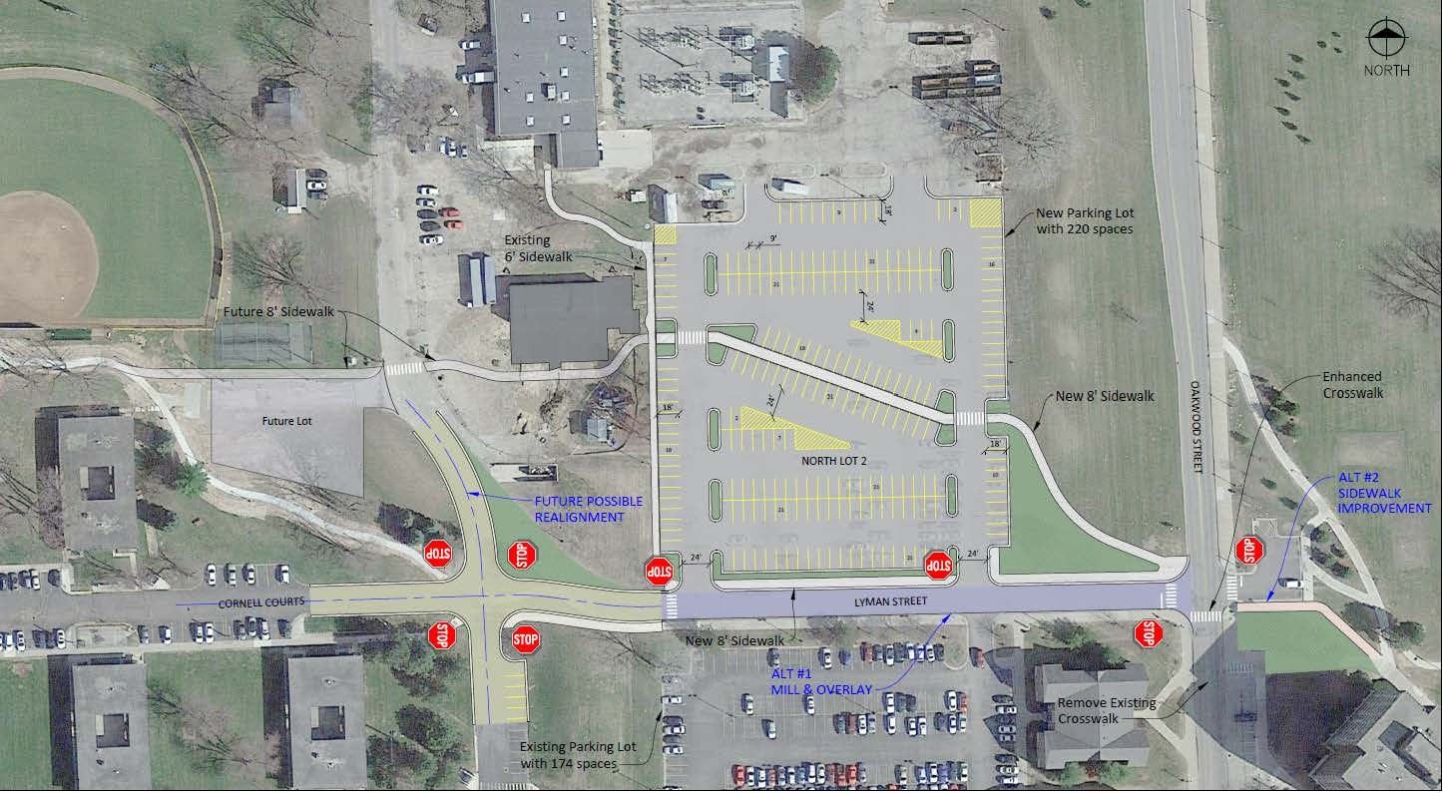
Green Lot II

Slide 36

Look Ahead

Slide 37
Upcoming Projects
(FY17, subject to Board Approval)
Heating Plant Co-generation system
    Replace existing turbine
      4.5MW to a new 7.8MW
    Total Project Budget $19.2M
    Will meet 98% of EMU’s heat and 93% of electric needs
      Current system meets 55% of heat and 51% of electric needs.
    Construction duration 16-18 months from BOR approval
    NEEDS BOR APPROVAL

Slide 38
FY18 & 19 Self Funded Projection ($26M)
Fiscal Year Amount
    College of Business, elevator 18 $250,000
    Wise Hall Renovation, phase IV 18 $2.8M
    Parking Improvement, TBD 18,19 $1.0M
    Campus Flatwork 18,19 $900,000
    Electrical Primary replace Loop 1 18,19 $7.5M
    Alexander Music Bld. renovations 18,19 $8.4M
    Roof replacement allowance 18,19 $700,000
    DC2, sanitary pipe replacement 18 $150,000
    Village & FYC finishes refresh 18,19 $800,000
    Campus Security Measures 18,19 $285,000
    Classroom Technology 18,19 $1.7M
    Rynearson Stadium improvements 18,19 $550,000
    Rynearson Stadium lighting replacement 19 $1.2M

Slide 39
FACILITIES PLANNING and CONSTRUCTION
Questions?
Thank you!

Slide 40

The Honors College at Eastern Michigan University
The Honors College at Eastern Michigan University serves the university community by empowering academically talented and motivated students to reach their full personal, scholastic, service, and leadership potential through challenging coursework with engaged peers and faculty and through extra-curricular activities that foster international and diversity awareness and a commitment to civic engagement.

Slide 41
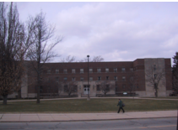
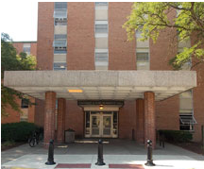
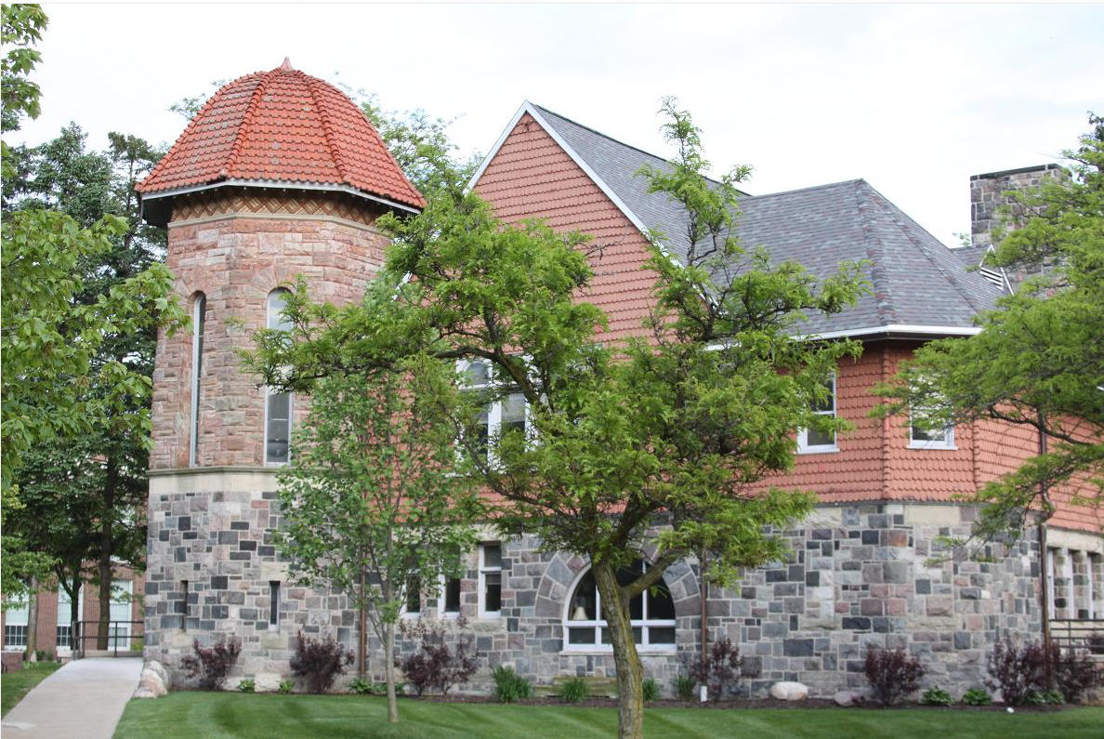
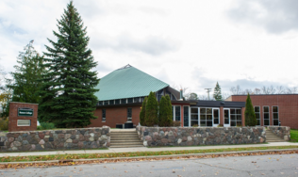
The Honors College History
Founded in 1984 by Dr. Robert Holkeboer and Dr. William Miller
Purpose: recruit, retain and reward academically talented students
Over 140 Honors sections are offered each year
  General Education, majors, and minors
  More than 1,600 members
  Across all five colleges and numerous academic departments
Jones and Goddard Hall (Inception-2002), Wise Hall (2002-2007), Starkweather Hall (2007-2016), and 511 W. Forest (January 2016 – Present)

Slide 42
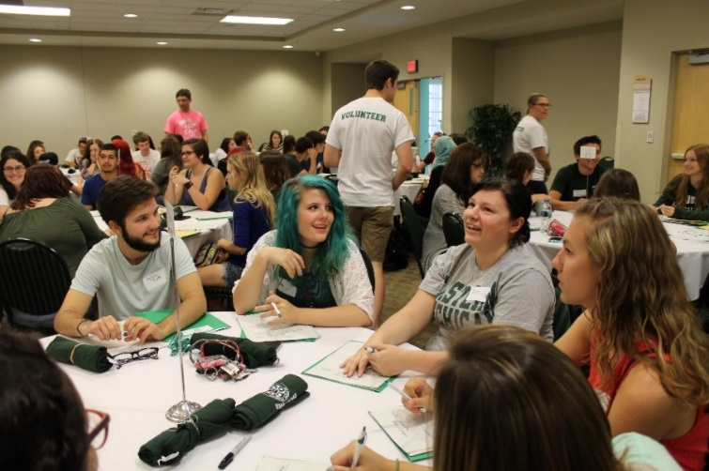
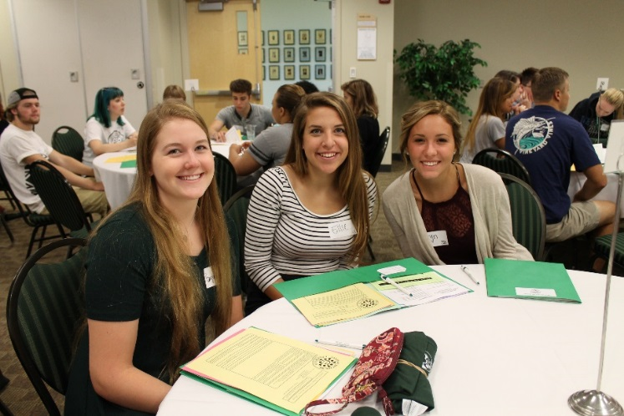
Orientation

Slide 43
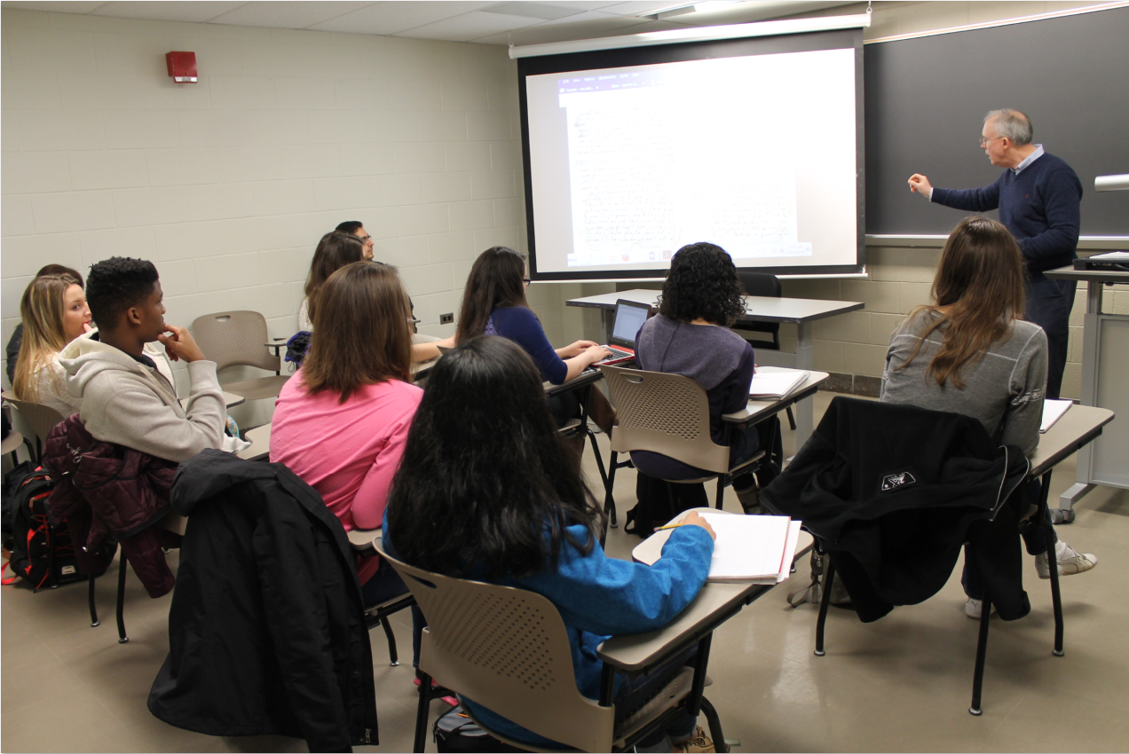
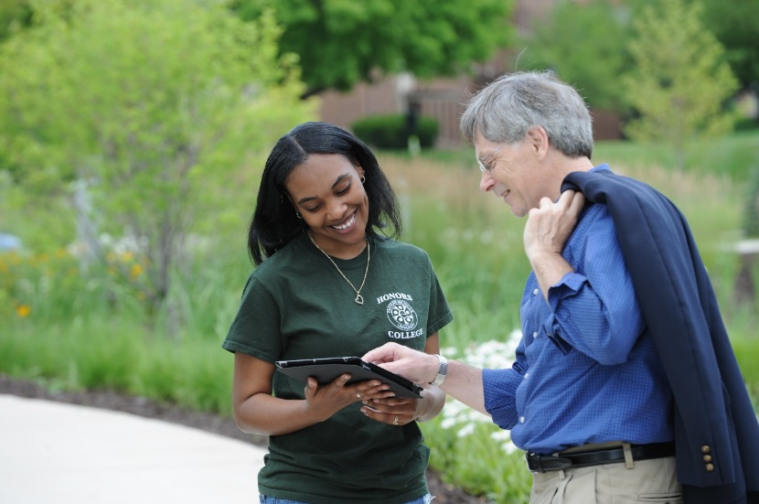
In The Classroom
Honors classes have a cap of 20 people!

Slide 44
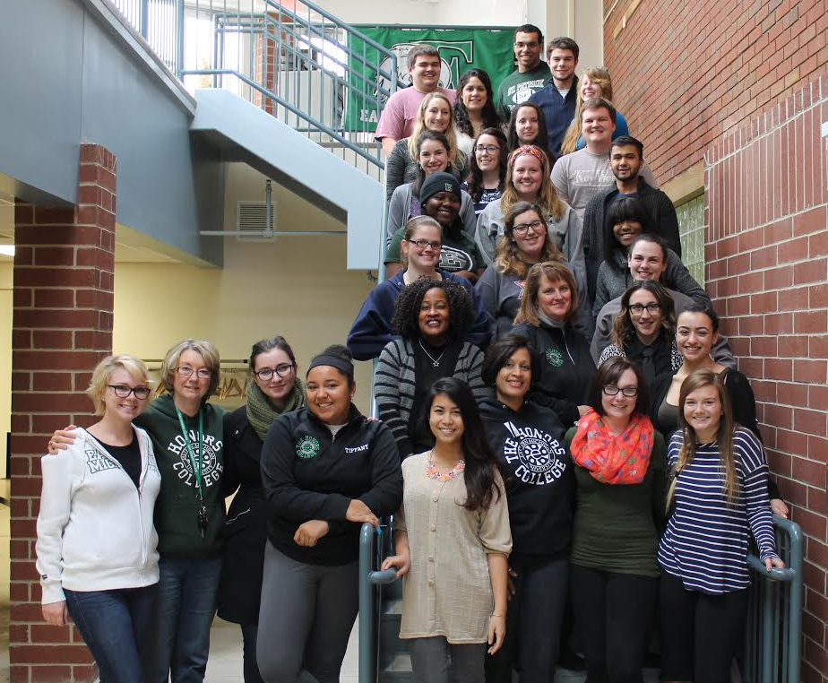
The Honors College Support!
Student Fellow Teams
Advising
Communications
Computing
Programming
Recruiting
Research

Slide 45
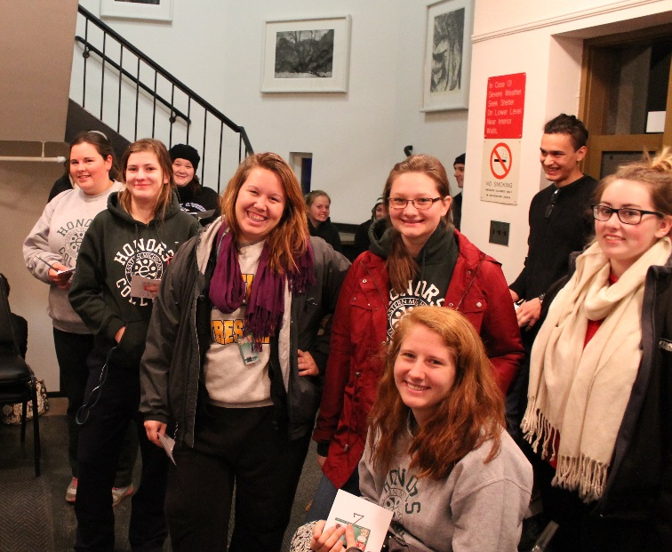
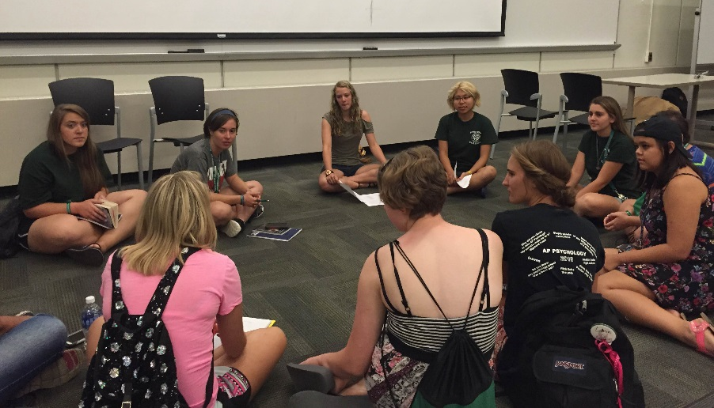
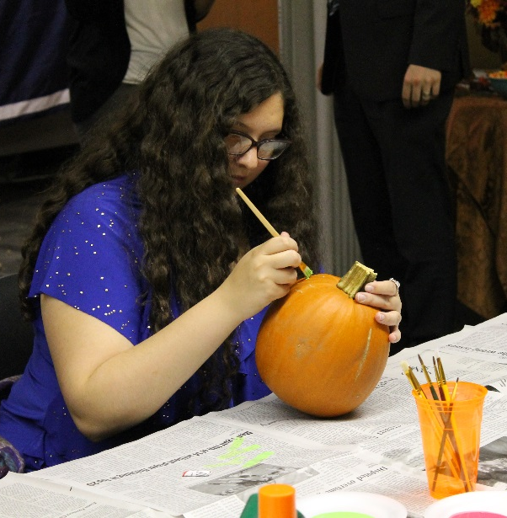
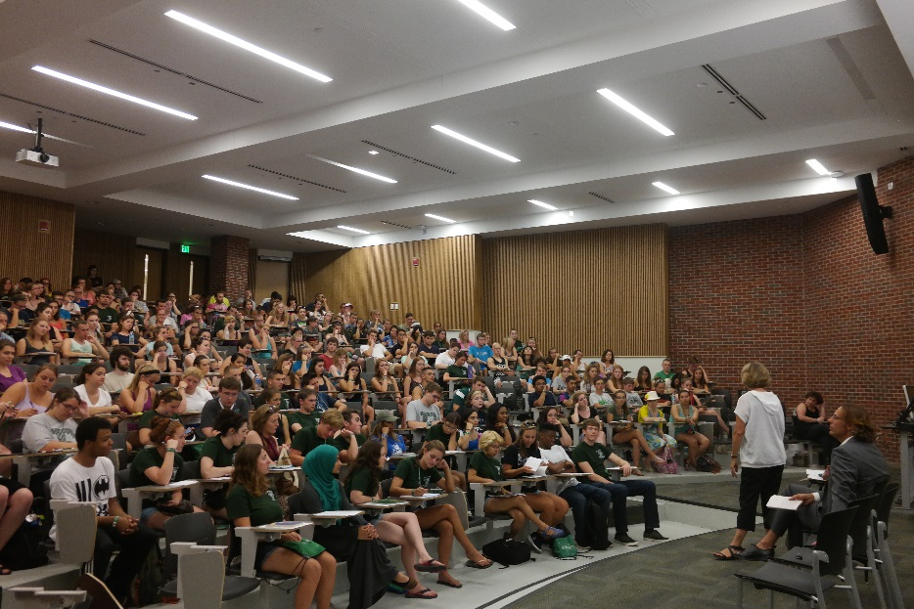
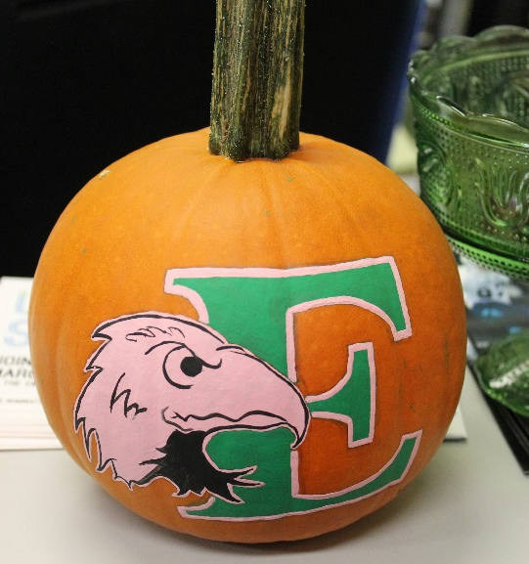
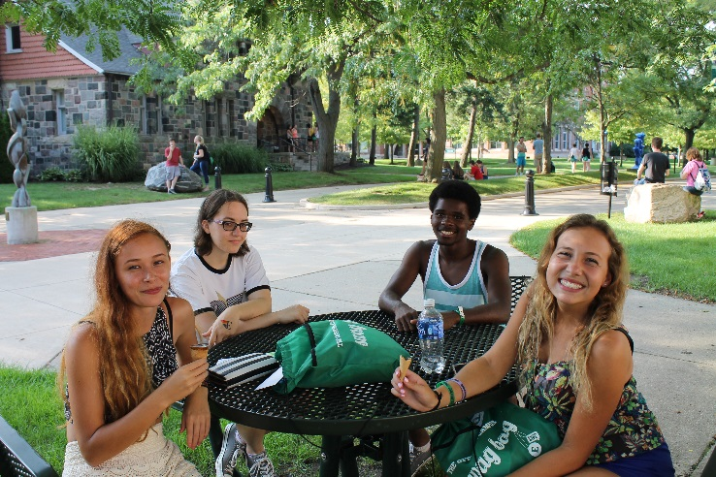
Pumpkin Painting
Honors Opportunities and Events
Beyond the Classroom
Common Read
Ice Cream Social

Slide 46
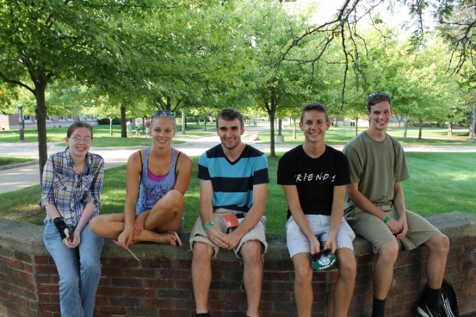



Staying in Contact with Our Students
Building an Honors Community!
Social Media – Connecting with students and engaging outside of regular business hours
  Facebook communication up15.3% in the last 6 months
  Twitter communication up 15.2% in the last 6 months
  Instagram communication up 68.9% in the last 6 months
Connecting with both prospective and current Honors students:
  2513 prospective students
  Fall 2015-Winter 2016 academic year: hosted 46 events with 1,316 attendees

Slide 47
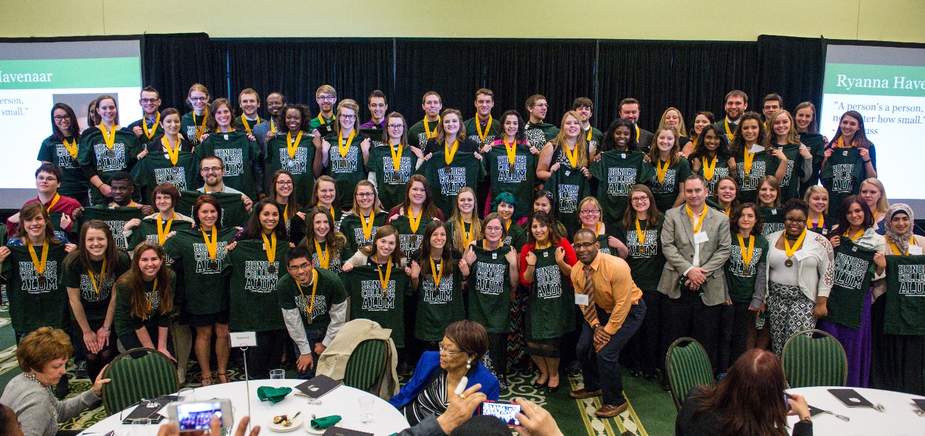
Honors Graduates
We stay in contact with
1,578 Honors alumni!

Slide 48
Graduation Rates
Year Admitted to EMU
Year Admitted to EMU

Slide 49

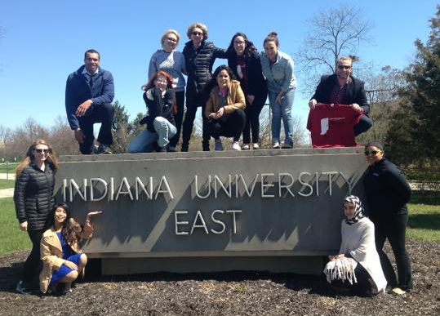

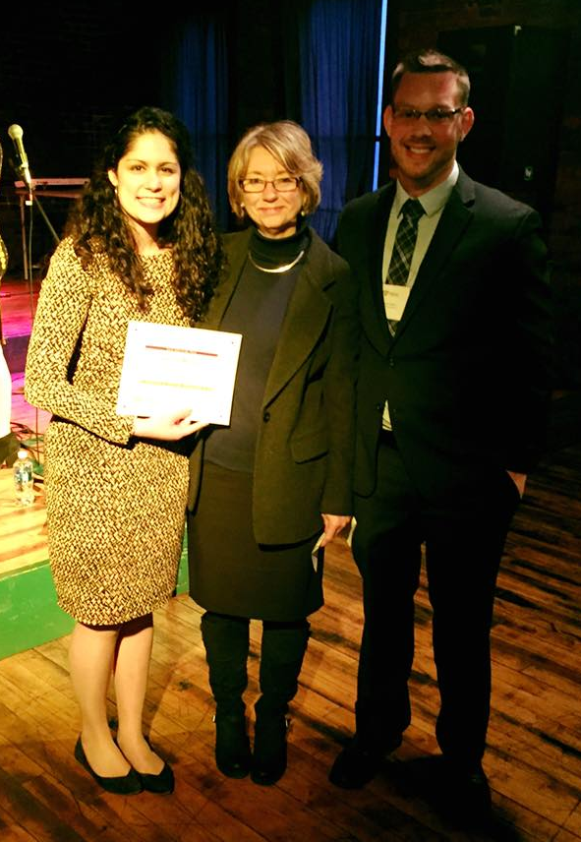
Upcoming Honors Events
100 of our Honors students will be featured on EMU banners!
EMU’s Lauren Renou received MEHA’s student of the
year award in April of 2016!
The MEHA conference of 2017 will be held here at The Honors College at EMU!

