Slide 1

Administrative
Leadership
Meeting
Wednesday, February 17, 2016
8:30 a.m.

Slide 2
State of Michigan Appropriations
In millions
- $6m per year decline from FY09
- Cumulative appropriation revenue lost due to declines since FY09 = $54m
- Real dollars, not adjusted for inflation

Slide 3
Student Credit Hour Budget vs. Actual

Slide 4
Expenses
In millions
Compounded Annual Growth Rate: 1.4%

Slide 5
Expenses (w/o Fin Aid)
In millions
Compounded Annual Growth Rate: 0.9%

Slide 6
Reserve Trends
Financial Reserves
In millions

Slide 7
Branding Research

Slide 8

Overall Objective
Strengthen Eastern’s brand awareness and perception among our key audiences
and Education First have served us very well
Time to revisit/refresh

Slide 9
Brand Research
Conduct comprehensive brand research to better understand current perceptions of the Eastern Michigan University brand
Quantitative and qualitative research
  Small group sessions
  Mass survey

Slide 10
Research Findings
Identify key points of distinction that will provide direction regarding:
  Evolving current TRUEMU / Education First campaigns
  OR
  Developing entirely new campaign

Slide 11
Research Partner
Selected through RFP process
National firms specializing in higher education brand research and development

Slide 12
OLOGIE
University clients include:
  Northwestern
  Purdue
  West Virginia
  Ohio University
  University of Buffalo
  … and others
Clients outside higher ed include:
  Food Network
  Lowes
  Cleveland Clinic
  BMW Financial Services

Slide 13

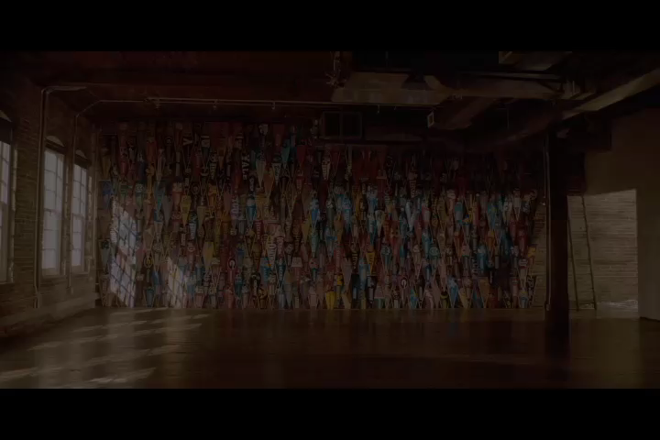
OLOGIE

