Slide 1

Faculty/Staff U.ACHIEVE
Let’s help them get their degree.

Slide 2
What is u.achieve?
u.achieve is the new degree evaluation tool purchased by EMU. This program will allow students and their advisor to track academic progress through graduation.
u.achieve includes all University requirements, the Fall 2007 General Education program, and most undergraduate Major and Minor programs offered by EMU.

Slide 3
Who can use u.achieve?
u.achieve has been built for all incoming Undergraduate students following both the Fall 2007 General Education program and the 2011-2012 or later catalog.
    NOTE: Students must be admitted to EMU as of Fall 2011, not have their major declared as of this term for the program to run successfully.
Graduate, Second Bachelor, and Teacher Preparation students will NOT be able to use this system.
Notes:
Current students who are following both the new Gen Ed program and the 11-12 catalog should be able to process an audit. Intent, undeclared, and non-graduatable programs have NOT been built and will result in an audit with Gen Ed only along with a message that students cannot graduate from this program.

Slide 4
Online access to your degree evaluation
Log into your my.emich account
Click on the “Faculty” tab at the top
Choose the “Faculty & Advisors” link
Click on “UG Degree Audit (u.achieve)” to be sent to your online evaluation
NOTE: You must be granted access to the system by your department head or director. If you do not have access, please have them send Amy Frady an authorization email at afrady@emich.edu

Slide 5
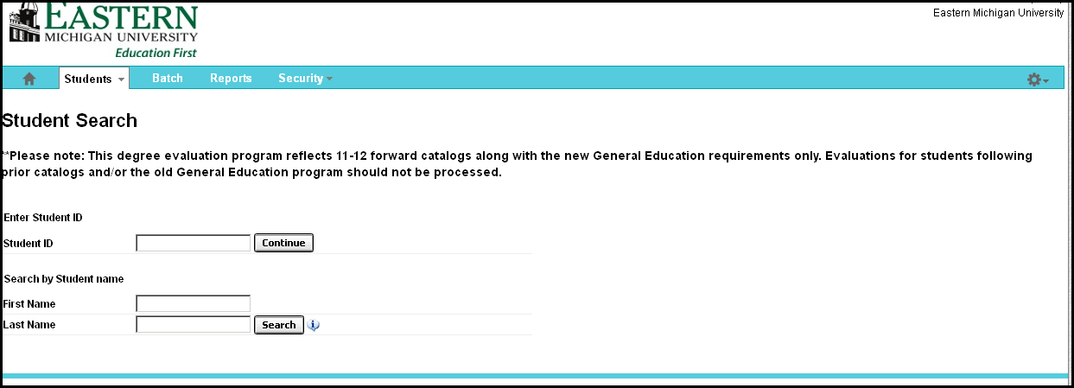
Where to start
On the “Student Search” page, enter the student number for the selected student (using a capital E), or you may search by name (be careful to select the correct student as searching by name may pull up more than one student.)

Slide 6
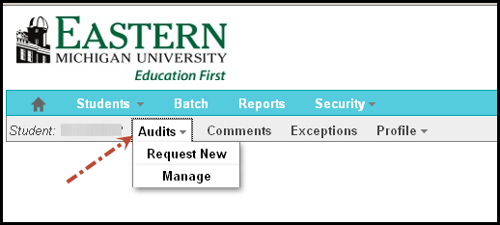
How to run a new audit
Click the “Audits” link at the top of the page next to the current student number you’re working with and select “Request New”

Slide 7
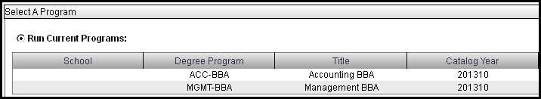

How to run a new audit
To choose the program on file (declared major/minor)
Click the “Run Current Program” radio button for the official program audit, if correct (watch the catalog year! Must be 201210 forward).
Submit the request by clicking on the “Run Audit” button at the bottom of the page

Slide 8
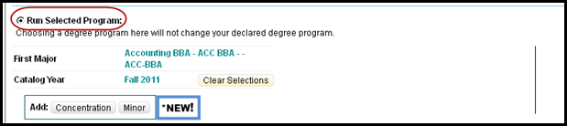
How to run a new audit
To select a new program
Click the “Run Selected Program” radio button for a What-if audit.
Choose the Degree Program you wish to view along with the catalog year (11-12 forward!)
Submit the request by clicking on the “Run Audit” button at the bottom of the page.

Slide 9
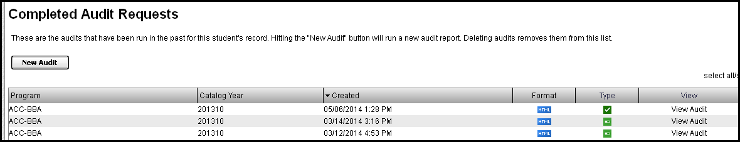
How to view an existing audit
Click the “Audits” link at the top of the page next to the current student’s number and select “Manage”
This will take you to the student’s “Completed Audit Requests” page (don’t worry, for the first time there may be nothing there!)

Slide 10
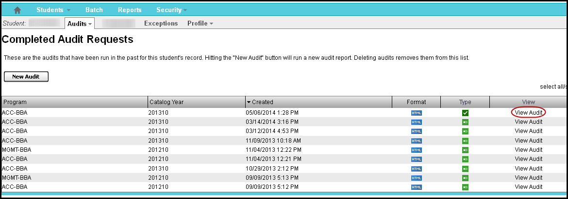
How to view an existing audit
To view a previously processed audit, click on the “View Audit” link next to the one you wish to view.

Slide 11
How to delete an audit
Currently, only administration in the Office of Records and Registration can delete an audit. Please contact them for assistance in 303 Pierce Hall or by phone at 734.487.4112.

Slide 12
How to read an online audit
There are messages that display at the top of each audit.
The first will tell the reader if the audit has been processed using a declared program, as listed on the official school record, or if the audit was run as a “What-If” scenario.
The next message will appear on all audits, regardless of program, indicating that there may be required pre-requisites not listed here and to contact the program advisor with questions.
Notes:
Remember – programs are built according to the catalog ONLY – no additional program requirements (such as admission requirements to a second admit program or GPA requirements that are not a part of the overall University policy) will be displayed and must be determined by an advisor.

Slide 13
How to read an online audit
At the top of every audit will be a header indicating the status of the overall audit. There are three different messages that may appear.
1)AT LEAST ONE REQUIREMENT HAS NOT BEEN SATISFIED – This indicates that there is at least one requirement that has NOT been fulfilled.
2) ALL REQUIREMENTS COMPLETED – IN-PROGRESS COURSES USED – This indicates that the audit is MET using in-progress courses and may change if courses are withdrawn or failed
Notes:
If there is a student with message number 2, make sure they apply for graduation!

Slide 14
How to read an online audit
3) ****ALL REQUIREMENTS IDENTIFIED BELOW HAVE BEEN MET**** - This indicates that the audit has been completely MET.
Note: Every area is considered a requirement; however, there may be several sub-requirements within each main requirement.
Notes:
For example, within a major there may be core courses along with additional requirements such as restricted electives that will show as individual sub-requirements for the main major requirement as a whole.

Slide 15
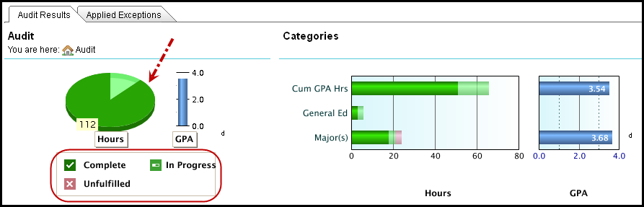
How to read an online audit
The top of the audit has a pie chart that shows all course hours applicable to the degree (hover the mouse over it for total).
Completed course totals are in dark green, in-progress courses are indicated in light green, and unfulfilled courses are shown in red.

Slide 16
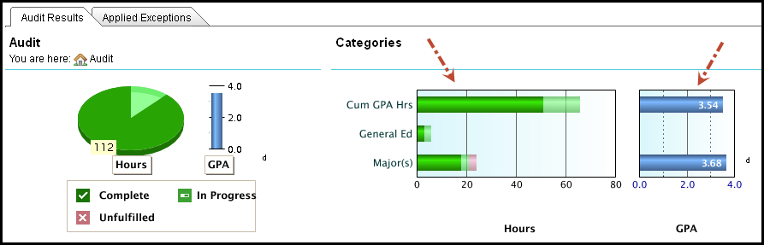
How to read an online audit
Completion graphs for Cumulative hours, General Education, and Majors/Minor areas are shown at the top of the audit along with cumulative and Major GPA graphs.

Slide 17
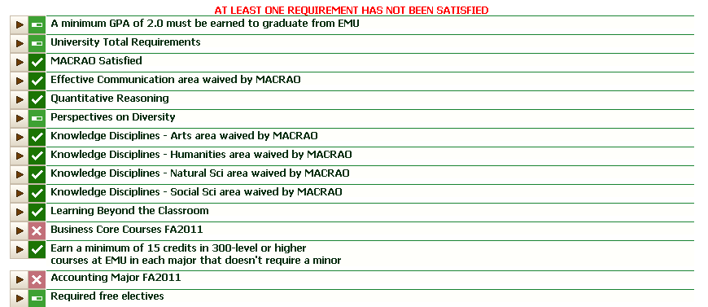
How to read an online audit
The body of the audit lists each of the required areas and indicates if they are Met (dark green check), In-progress (light green progress bar), or Unfulfilled (red “X”). You may drill-down for more information.

Slide 18
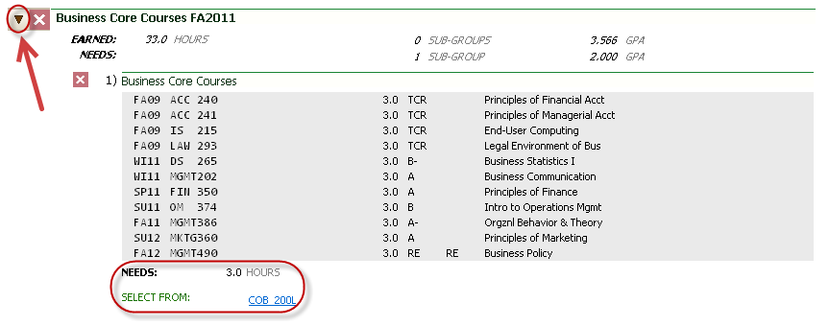
How to read an online audit
Click on the arrow next to the requirement for which you would like additional details. This will give you specific information about what has been taken and what is still outstanding.

Slide 19
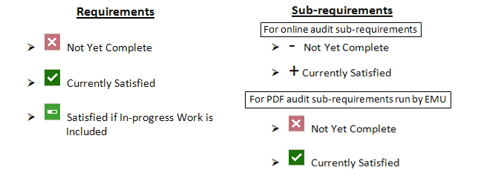
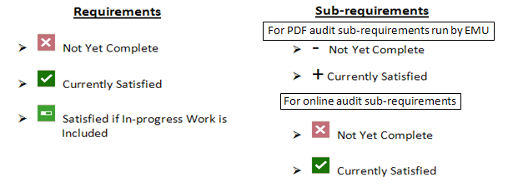
The online audit key/legend
The status of the main requirement will be determined by one of the symbols listed under “Requirements” while the status of the individual area sub-requirements will be determined by one of the symbols under “Sub-requirements”

Slide 20
Online documentation
Is this information posted anywhere online?
YES – it is!!
Please visit our website at www.emich.edu/registrar/uachieve for information and printable documentation regarding u.achieve.

Slide 21
Questions??
Contact Amy Frady in the Records and Registration Office in 303 Pierce Hall, by phone at 734.487.4112, or via email at uachieve@emich.edu.

